Slide 1
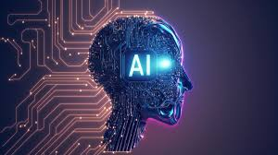

Slide 2
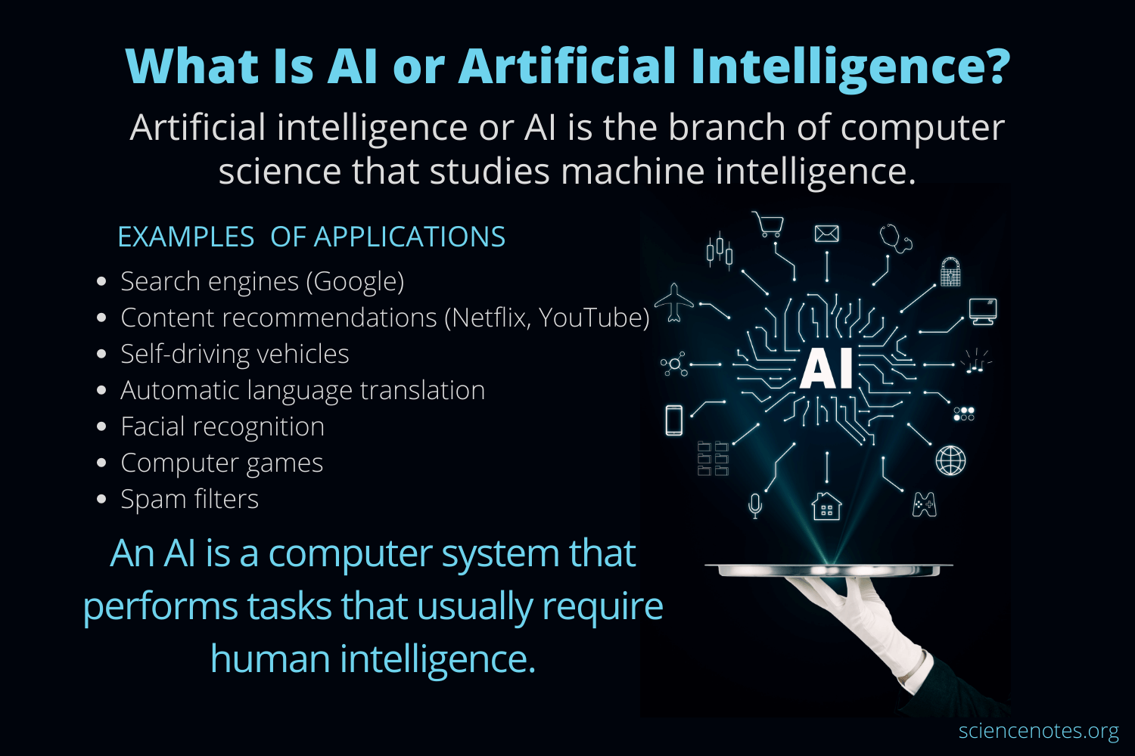

Slide 3
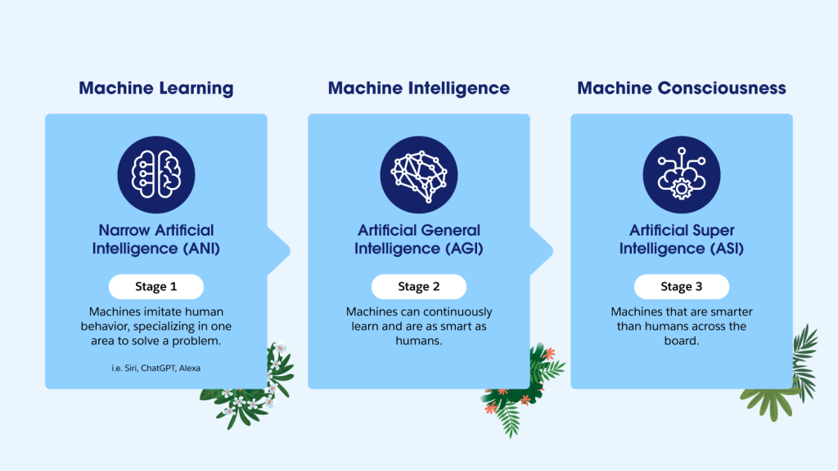

Slide 4
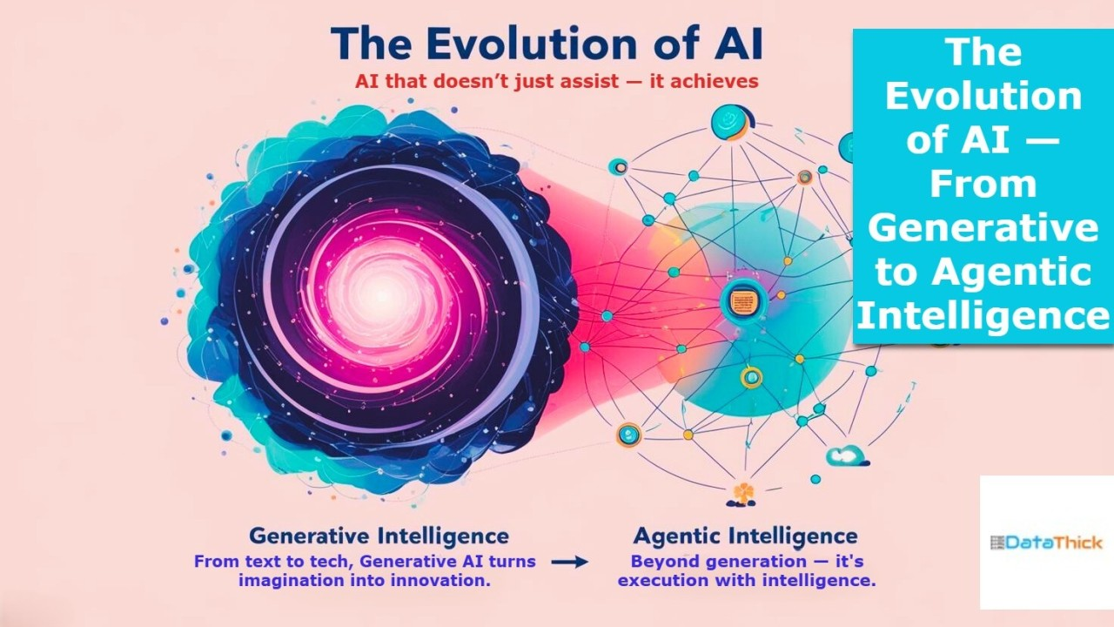

Slide 5
Why AI Is Evolving into Agentic AI
Traditional AI systems are primarily designed to predict outcomes and respond to inputs. Their intelligence remains reactive and limited to predefined tasks.
Agentic AI represents the next evolution, enabling systems to make decisions, plan actions, and operate autonomously toward defined goals.
This shift marks a transformation from passive intelligence to active, goal-driven systems capable of independent action.

Slide 6
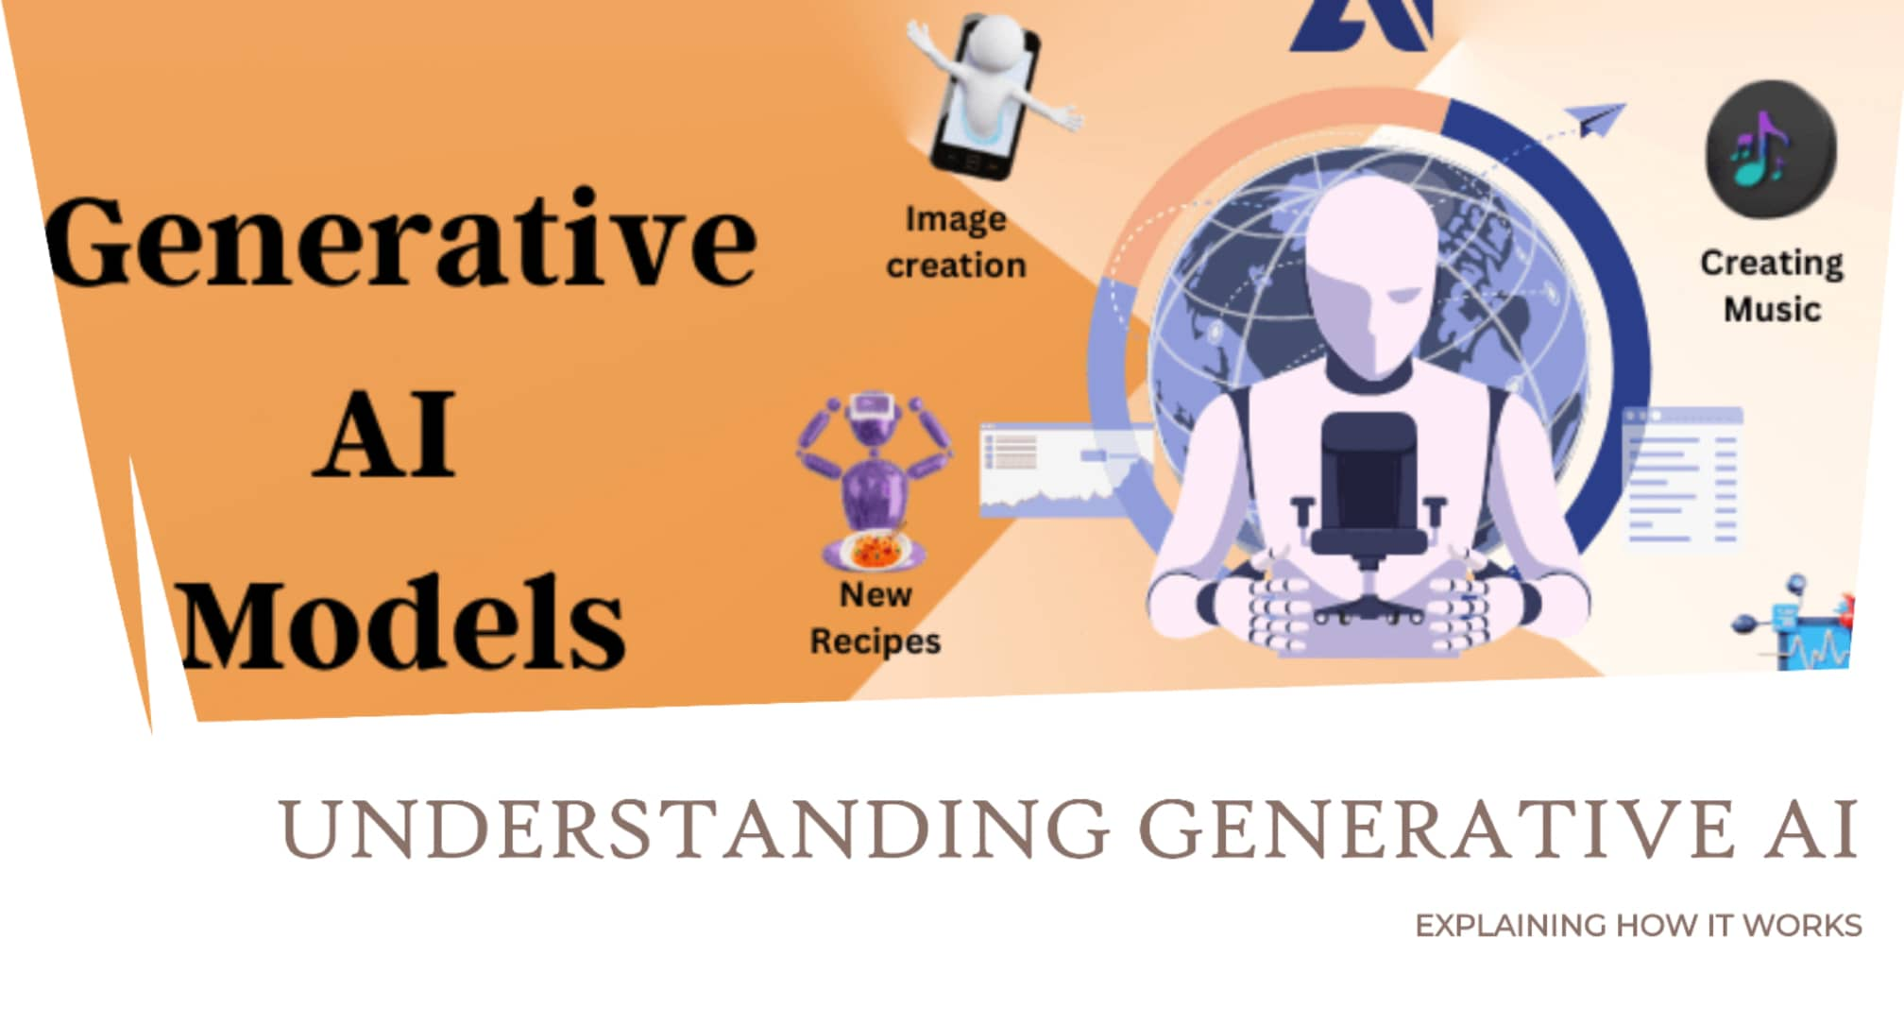

Slide 7
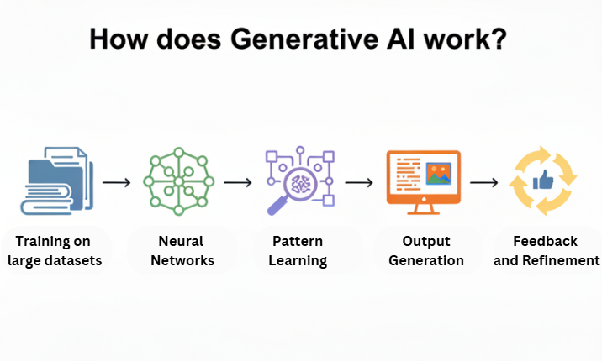

Slide 8
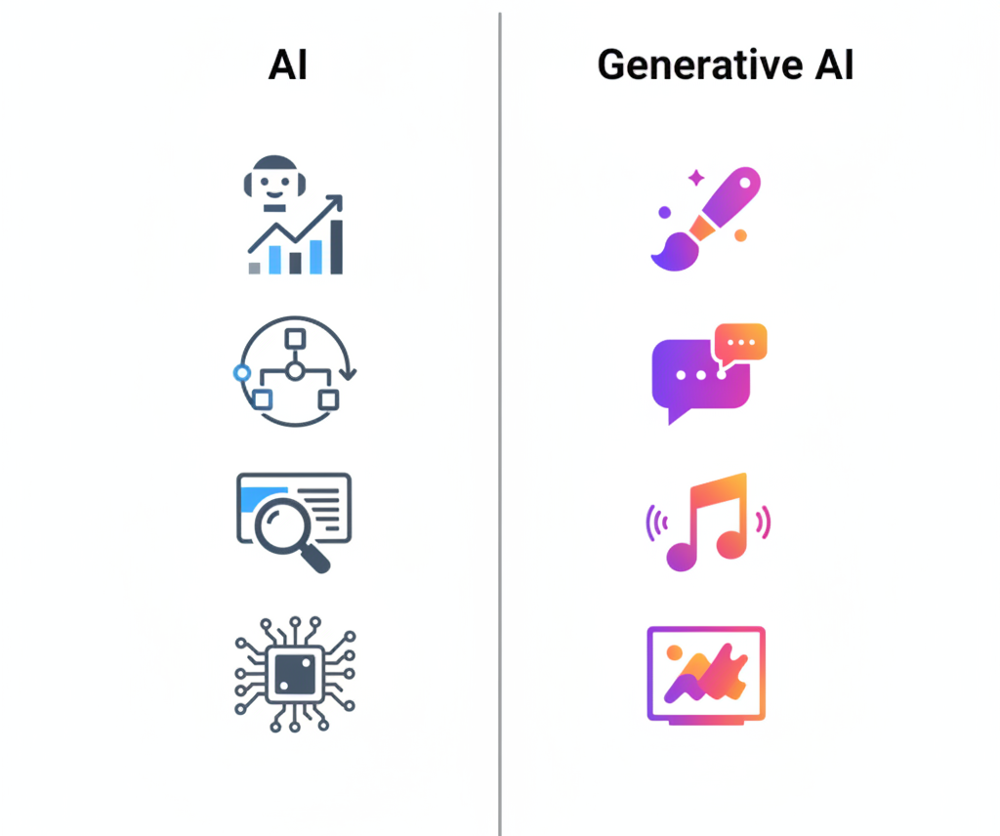

Slide 9
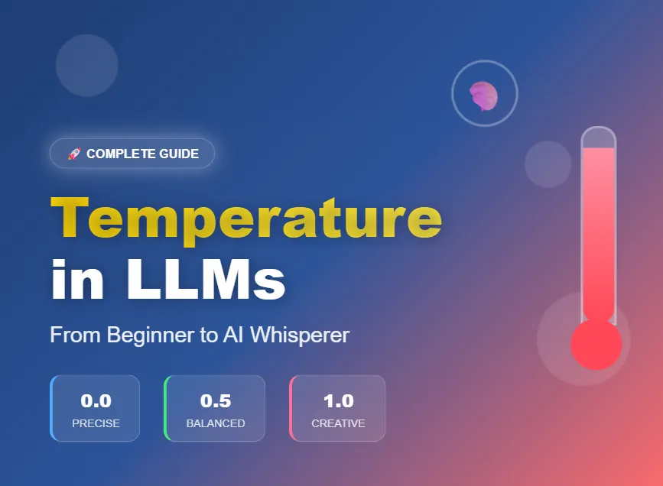

Slide 10
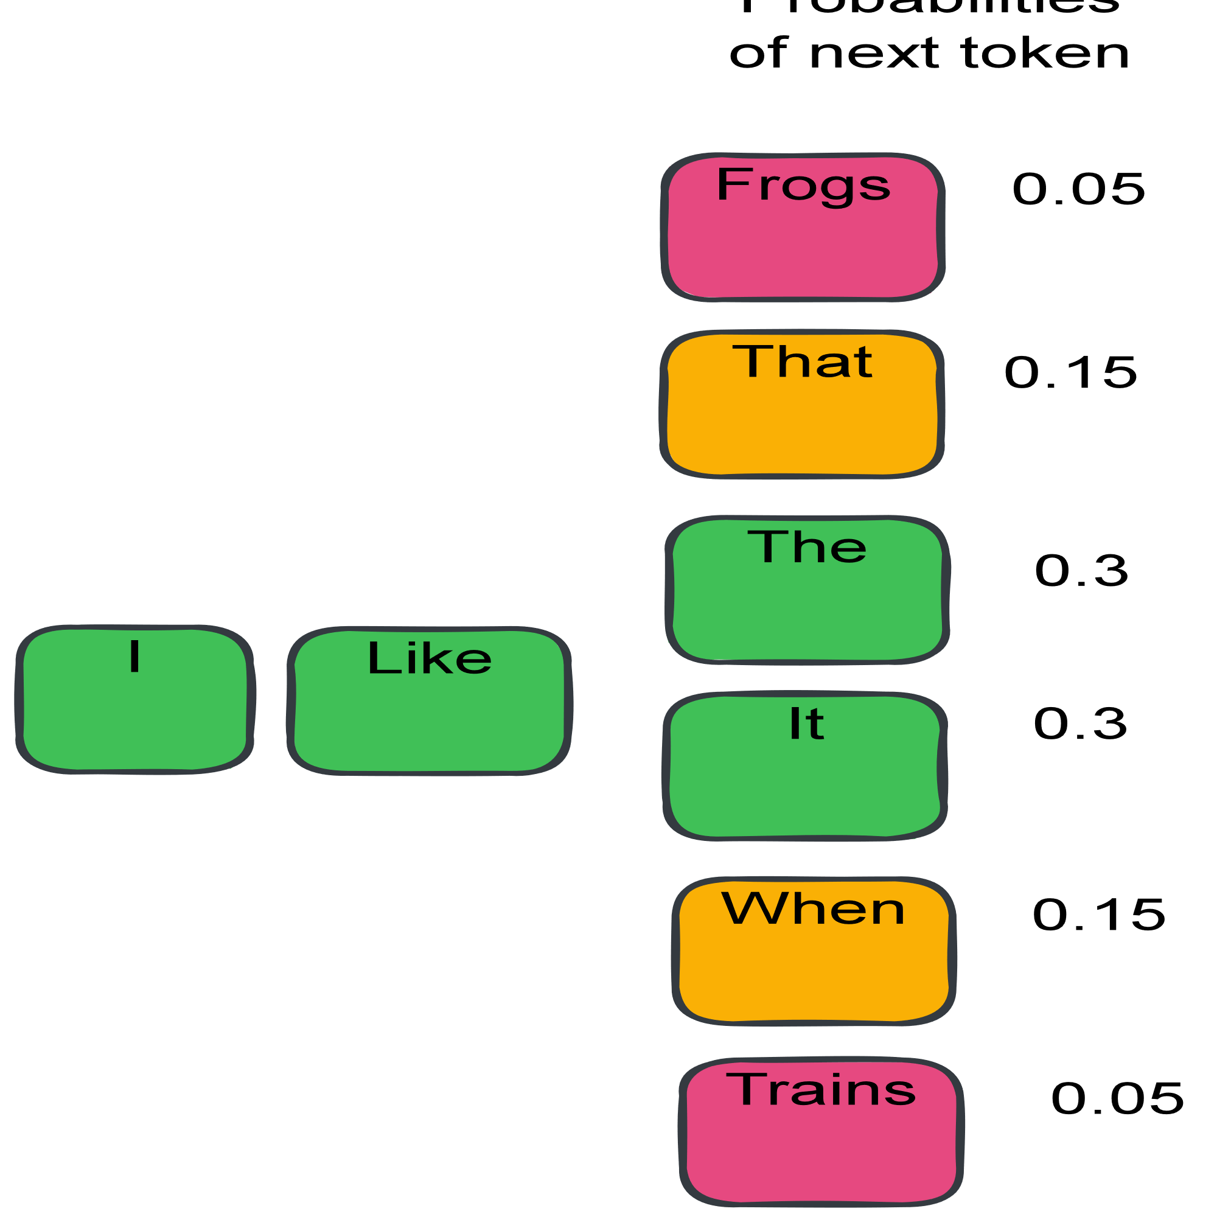

Slide 11
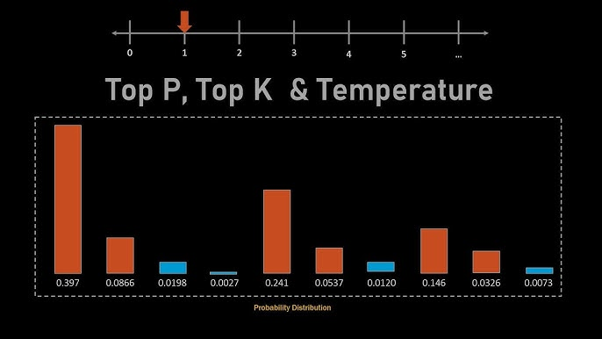

Slide 12
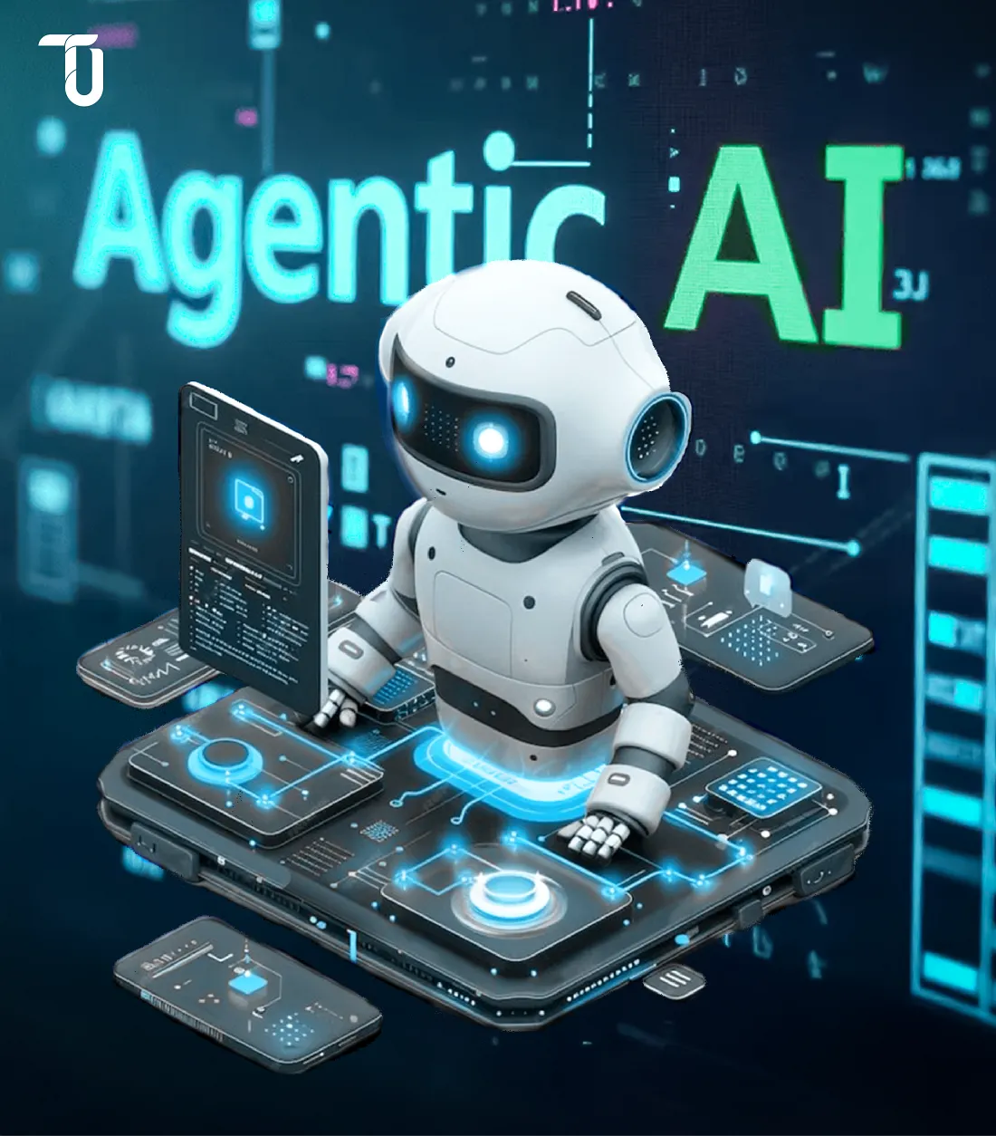

Slide 13
What Is Agentic AI?
Agentic AI refers to AI systems that can independently pursue goals by planning, deciding, acting, and adapting over time—often using tools and memory—rather than only responding to prompts.
How Agentic AI Works (Core Idea)
An agentic system follows a continuous loop:
Goal → Plan → Act → Observe → Reflect → Improve
This loop allows the system to:
Decide what to do next
Use tools (APIs, databases, web, code)
Remember past actions and outcomes
Correct itself based on feedback

Slide 14
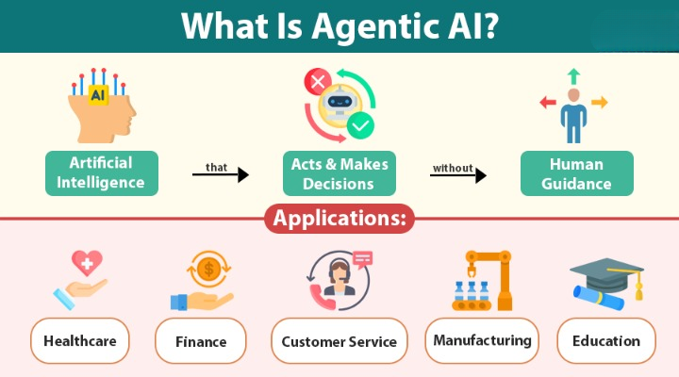

Slide 15
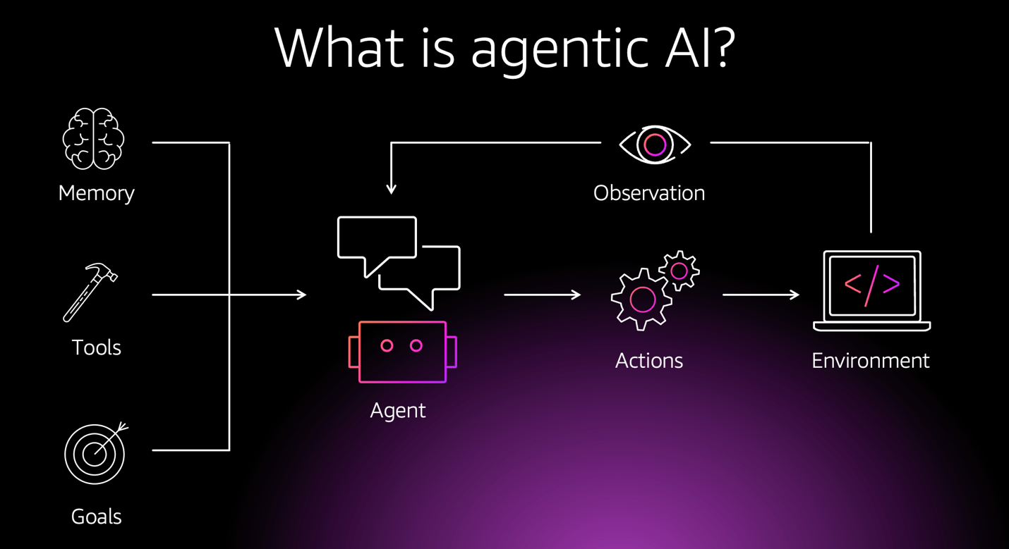

Slide 16
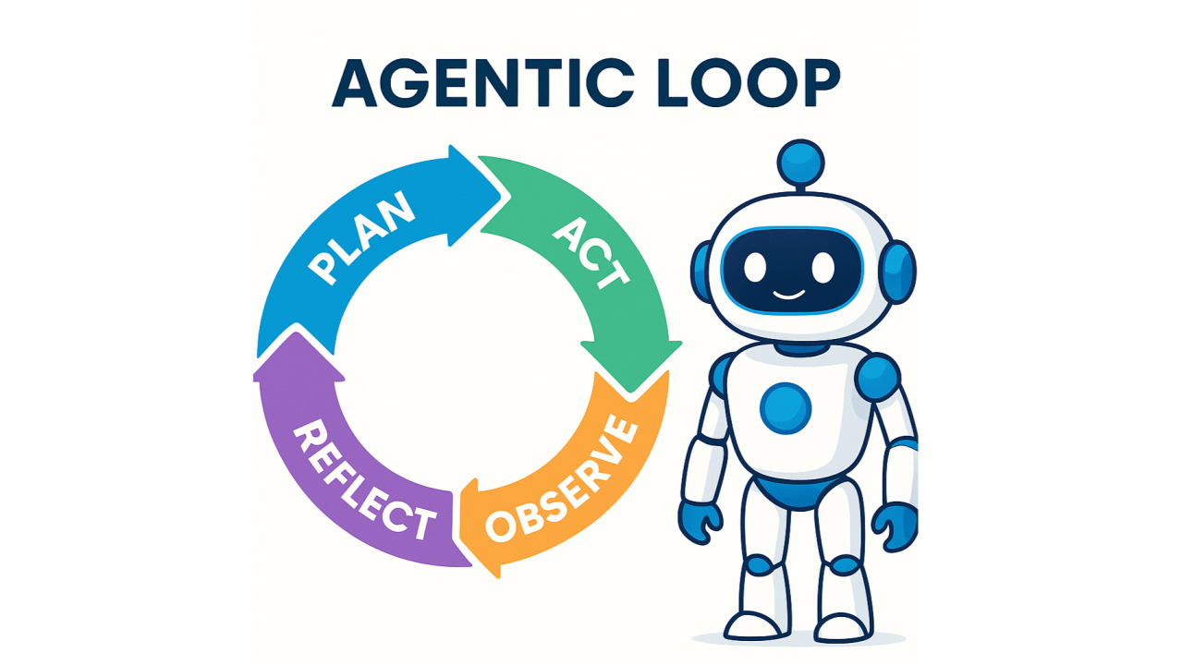

Slide 17
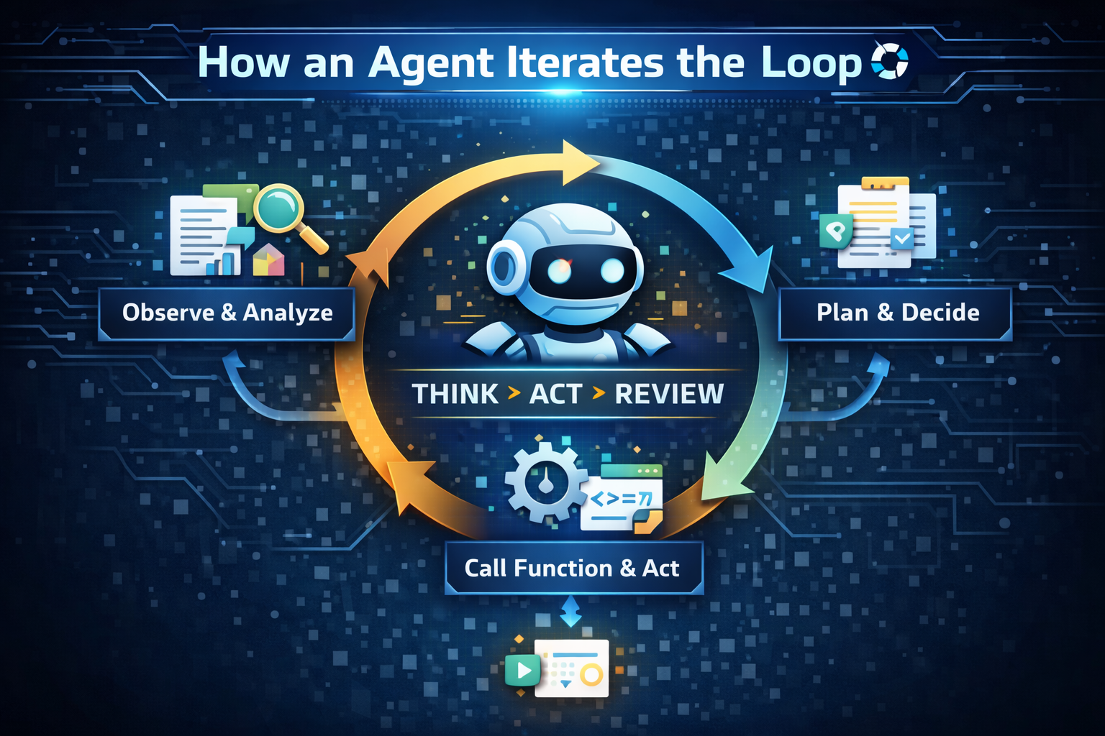

Slide 18
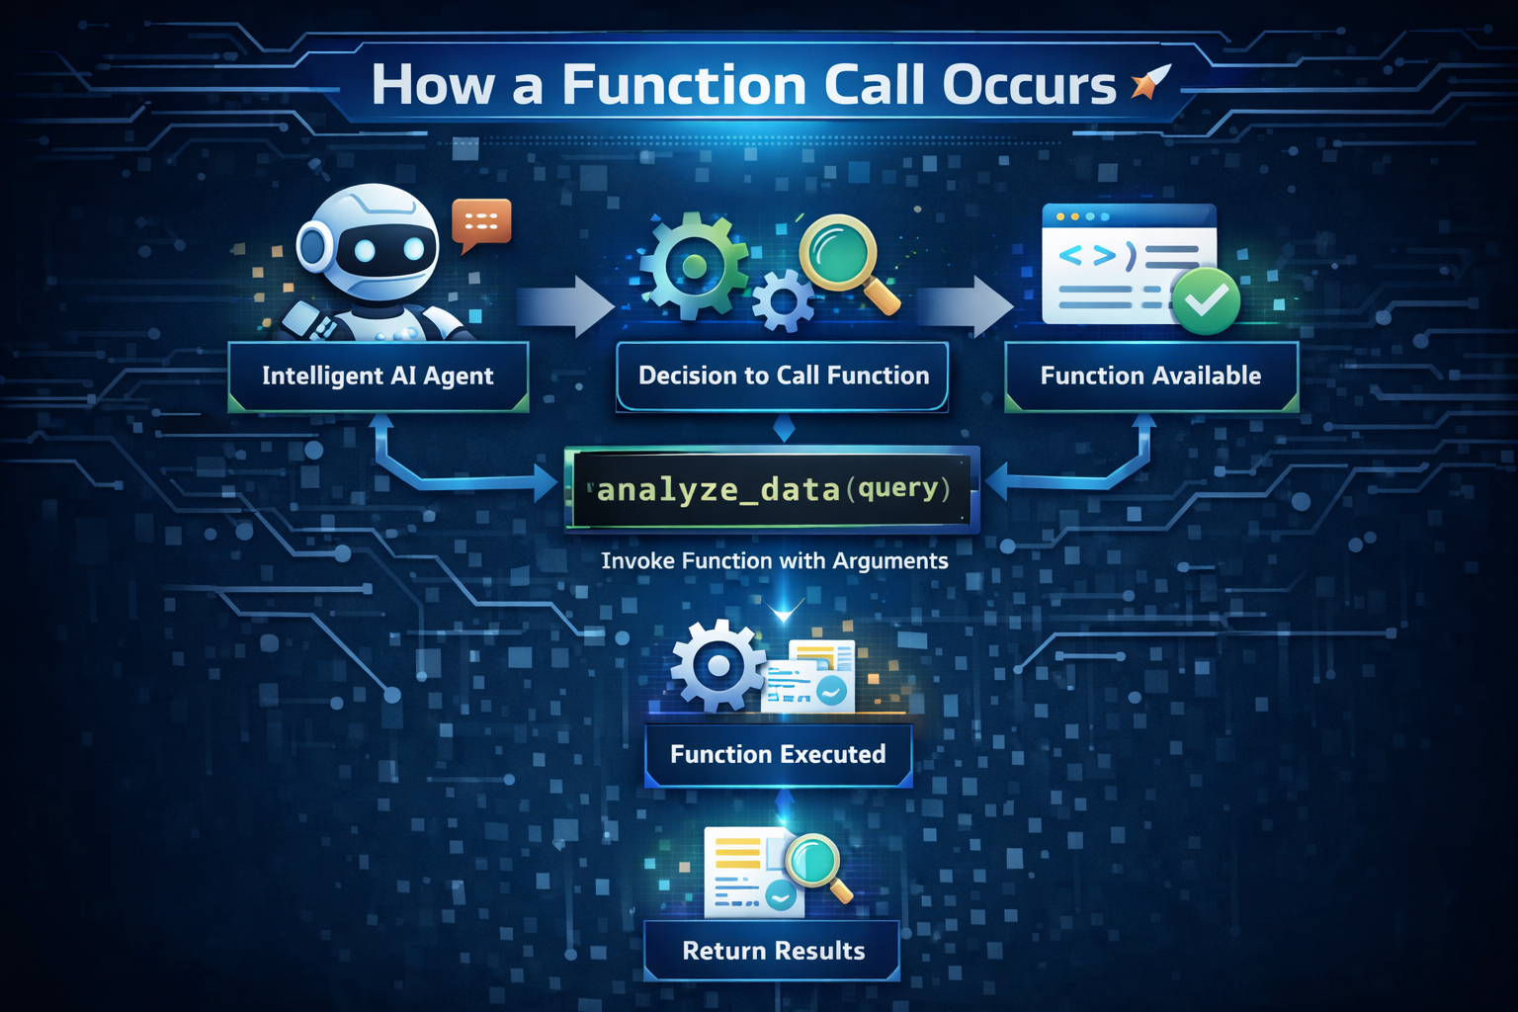

Slide 19
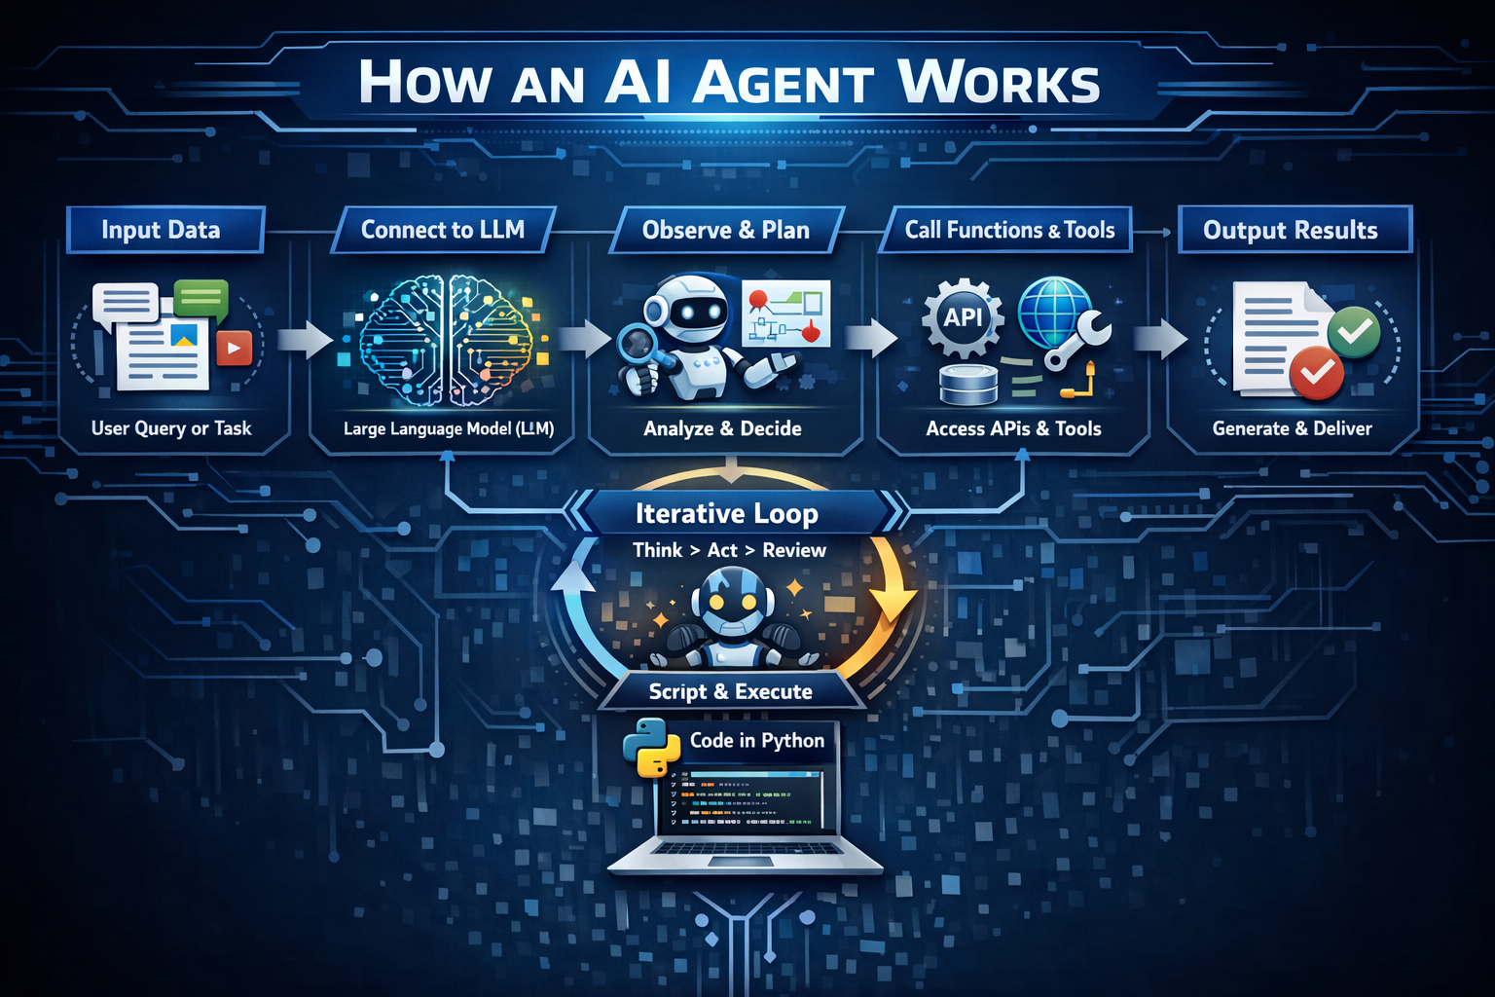

Slide 20
What Are CLI Agents?
CLI agents (Command-Line Interface agents) are AI-powered assistants that operate directly inside the terminal. They allow developers to interact with AI using commands, scripts, and system context—without leaving the development environment.
A CLI agent is an AI system that:
Runs in the terminal (bash, zsh, PowerShell, etc.)
Understands natural language instructions
Can read, write, and modify code
Executes commands, scripts, and workflows
Interacts with files, repositories, APIs, and tools
Operates in agent loops (think → act → observe → repeat)
Examples:
Gemini CLI
Cursor CLI
Claude Code
Open-source tools like Aider, Continue, OpenDevin (CLI modes)

Slide 21
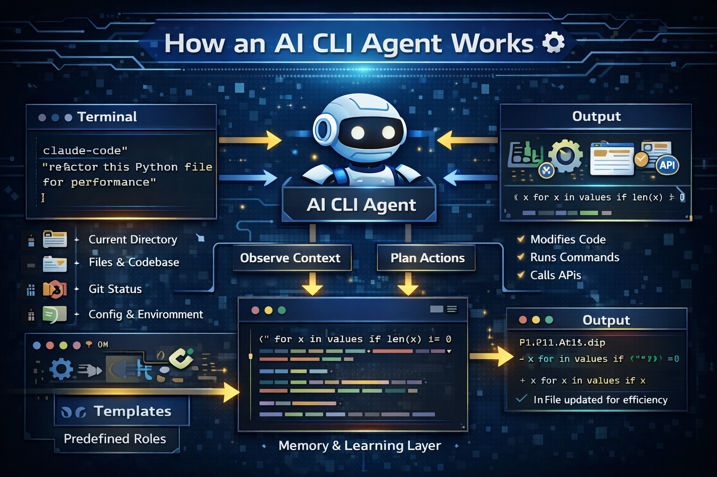

Slide 22
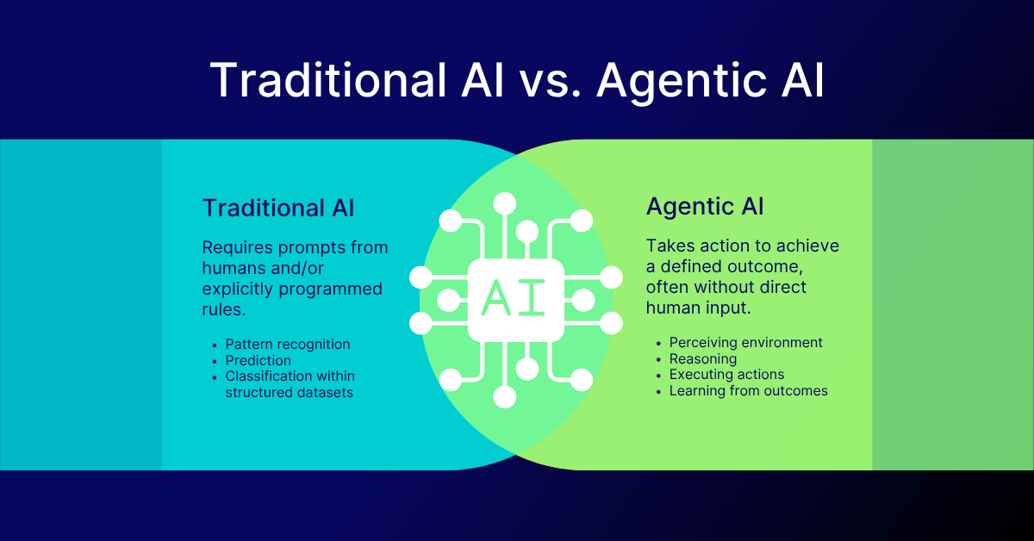

Slide 23
What Is an Agent Factory?
An Agent Factory is a systematic framework for designing, generating, deploying, and managing AI agents at scale—in much the same way a software factory produces applications using standardized processes, reusable components, and governance.
An Agent Factory is an architecture that enables organizations or individuals to:
Rapidly create AI agents for different tasks
Reuse shared intelligence components (LLMs, tools, memory, policies)
Continuously improve, monitor, and govern agent behavior
Deploy agents across multiple domains and platforms
Think of it as a production line for intelligent agents.
Just as factories mass-produce machines, Agent Factories mass-produce intelligent digital workers.

Slide 24
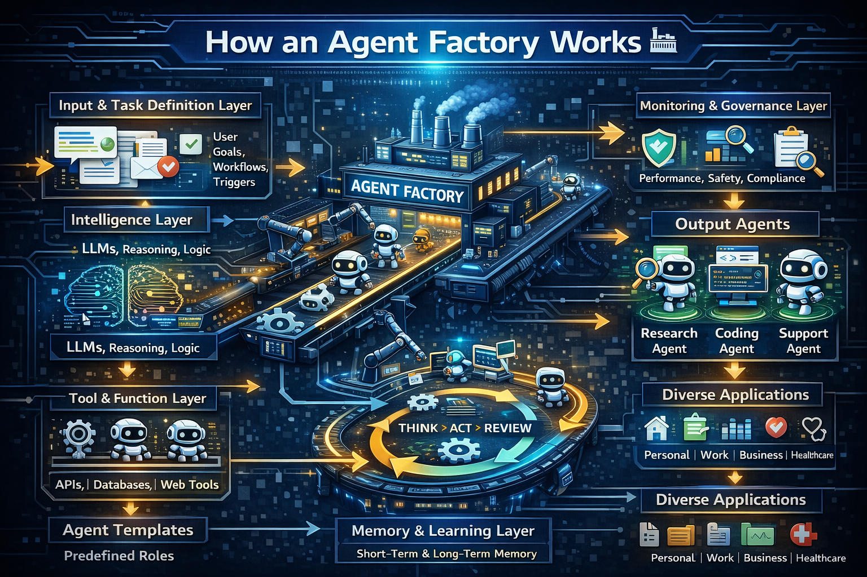

Slide 25
Agentic AI: Automating & Orchestrating the World 🤖
Autonomous agents that observe, plan, act, and iterate using tools, APIs, and code.
Transform society by automating repetitive tasks, boosting productivity, personalizing learning, and optimizing business operations.
Human-designed workflows allow agents to manage complex systems while ensuring safety, ethics, and transparency.
Outcome: Agents handle complexity, freeing humans to focus on strategy, creativity, and innovation.

Slide 26
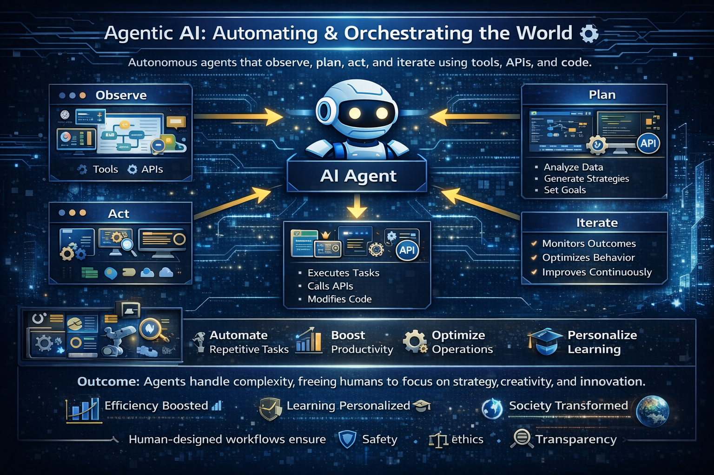

Slide 27
TOOLS USED FOR AGENT DESIGING:
n8n – Open-source workflow automation for integrating APIs and AI agents.
Zapier – Connect apps and automate tasks with minimal coding.
Make (Integromat) – Visual workflow automation platform.
Tray.io – Enterprise-grade automation for workflows and agents.
Retool – Build internal tools and dashboards with agent integrations.
Agent Builder – Visual workflow builder for agent logic.
OpenAI Platform
AgentKit – Full toolkit including drag‑and‑drop builder and connectors.
OpenAI
OpenAI Agents SDK – Code‑centric toolkit for custom agent creation.
OpenAI Platform
ChatGPT agent features – Built‑in autonomous capabilities within ChatGPT.

